Slide 1
How do robots understand the programming language?

Slide 2
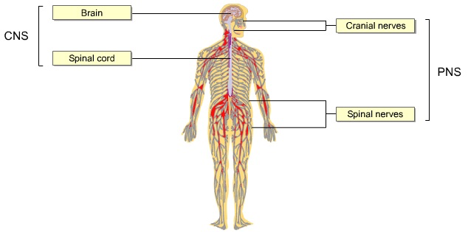

Slide 3
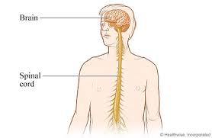
Central Nervous System
Made up of the brain and the spinal chord.

Slide 4
Peripheral Nervous System
All side nerves
Nerves are cells.
Made up of axons and dendrites.
Sends information in on / off signals that release chemicals

Slide 5
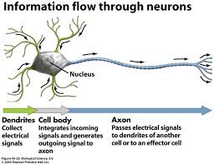

Slide 6
Your senses / sensory neurons collect information
…and send it back to the brain for processing, and for orders.

Slide 7
A Robot is a Computer
…that operates by on / off switches (binary code).
Notes:
You program a series of commands which essentially tell the robot where to send electrical signals.
Think about if you wanted to move your right hand. Your brains sends an electrical signal to only the nerves in your right hand which makes the muscles move.
Think about if you put your hand on a stove. The nerves in your hand send the signal “hot, what do we do?” to your brain which sends the signal “move” back to your hand.

Slide 8
For each part of the human nervous system below, name a part of a robotic system that does a similar function.
Central Nervous System
Nerves
Senses / Sensory Neurons
Motor Neurons

Slide 9
Create a Concept Map
Central Nervous System
Peripheral Nervous System
Brain
Nerves
Spinal Cord
Axon
Dendrite
Senses
Motor Neurons
Use the words to the left to explain in a
Concept map
Flow chart
Diagram
how the human nervous system is like that of a robot.

Slide 10
Sensory Lab
Get into pairs (someone you have not worked with before in this class)

Slide 11
What is the robotic programming language?

Slide 12
Binary Code

Slide 13
Computers only recognize two states of being.
On or Off
Notes:
In binary, that is either a 1 (on) or 0 (off).
Our decimal system is also known as a base 10 system. This means that we use 10 different symbols to count.
Binary Code is also known as a base 2 system. This means that we use 2 different symbols to count.

Slide 14
Letters in the alphabet are…
…converted to numbers and then…
…converted to a combination of 1s and 0s.
Notes:
In Binary, the letters of the alphabet must be given a number (1-26) which is then converted to Binary Code, a combination of 1s and 0s.
American Standard Code for Information Interchange (ASCII) uses a 7-bit binary code to represent letters and other characters. Each character is assigned a number from 0 to 127.

Slide 15
https://www.youtube.com/watch?v=kcTwu6TFZ08
Binary Basics

Slide 16
https://www.youtube.com/watch?v=wCQSIub_g7M#t=111
How to Read Text in Binary

Slide 17
To read Binary: Letters…
Break it into 8-bit sections
Each section equals a character
Upper case letters start with 010
Lower case letters start with 011
Why can you ignore the first three numbers of each section?

Slide 18
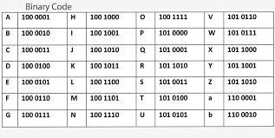

Slide 19
To read Binary: Numbers…
Break it into 8-bit sections
Each section equals a character
Each place value of the binary number is a power of 2.
To convert a decimal number to binary, you need only subtract the largest power of 2.
To convert from binary to decimal, add up the columns (see next slide).

Slide 20
Binary
128 | 64 | 32 | 16 | 8 | 4 | 2 | 1
2⁷ | 2⁶ | 2⁵ | 2⁴ | 2³ | 2² | 2¹ | 2⁰
Example
128 | 64 | 32 | 16 | 8 | 4 | 2 | 1
1 | 1 | 0 | 0 | 1 | 0 | 0 | 0

Slide 21
Practice
01000011
00000010 00110101

Slide 22
